Slide 1
Do you have e2e test?

Slide 2
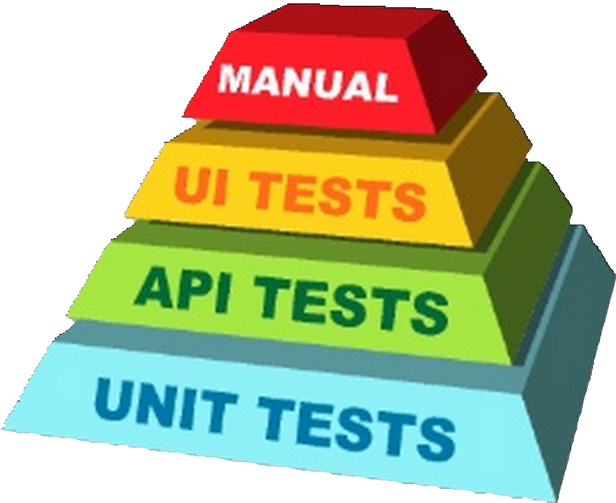

Slide 3

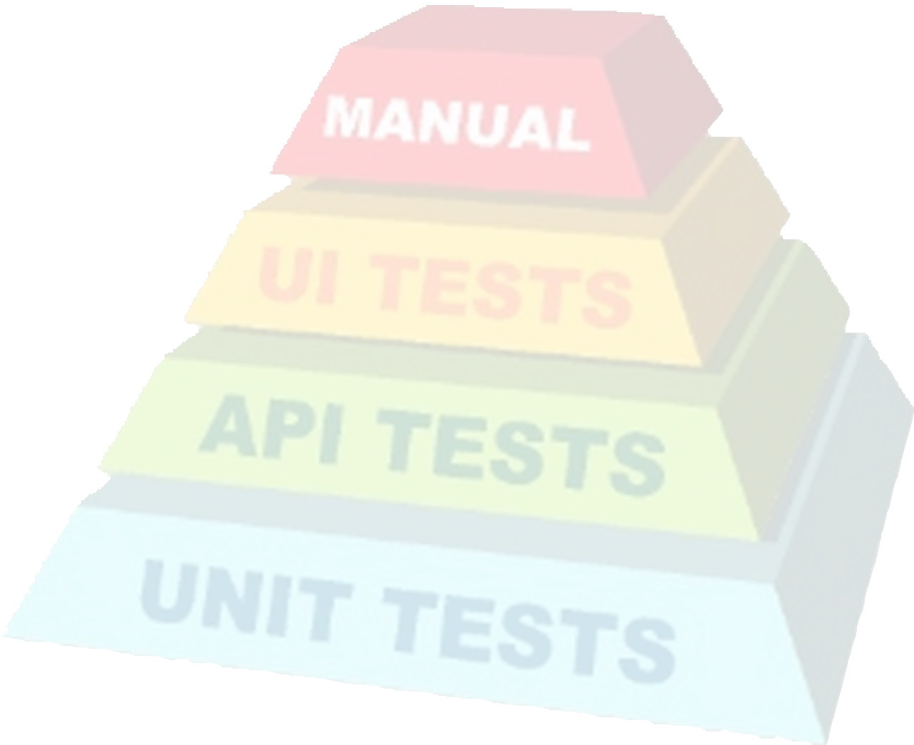



Slide 4
Maybe QA team in E2E?

Slide 5
How many resource do you have?

Slide 6
Test UI by yourself.
Stand out DRY principle

Slide 7
There are so many UI auto test tool.

Slide 8






Slide 9
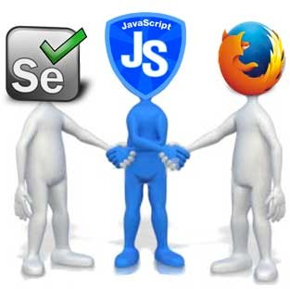



Slide 10
that sounds great, lets code for e2e test

Slide 11
But e2e test so hard

Slide 12
Less
•
hard to code
•
assertion is bad
•
have to know deeply flow control
•
big gap for newbie

Slide 13
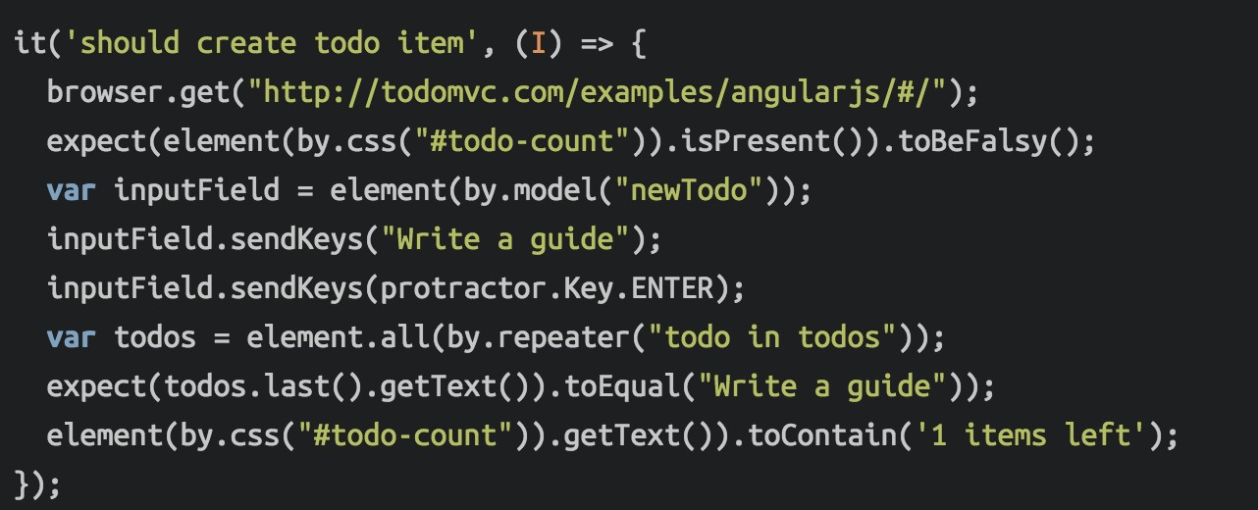
Protractor

Slide 14
Protractor
Go to target Url

Slide 15
Protractor
An assertion

Slide 16
Protractor
Selector and do something

Slide 17
Protractor
Another assertion

Slide 18




Protractor
Another assertion
What the …

Slide 19
E2E codecept.io

Slide 20

http://codecept.io/

Slide 21
codecept.js
•
Every command is described as an action of a user visiting a site.
•
CodeceptJS provides a general high-level API which can easily be executed
•
Control browser in realtime with API of CodeceptJS

Slide 22
codecept.js
•
Synchronous Tests API
•
user's perspective
•
Backend agnostic
•
PageObjects supported
•
Written in ES6 without transpilers.

Slide 23

codecept.js

Slide 24



codecept.js
Helper

Slide 25
Codecept.js VS …

Slide 26
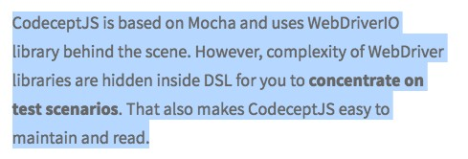
VS
•
sss

Slide 27
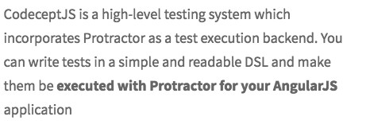
VS
•
sss

Slide 28

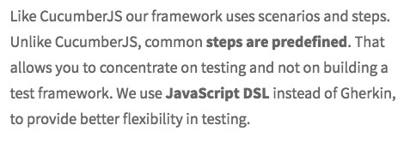
VS
•
sssss

Slide 29
Codecept.js example

Slide 30
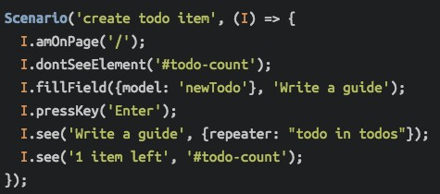
codecept.js

Slide 31
codecept.js
Go to target Url

Slide 32
codecept.js
An assertion

Slide 33
codecept.js
Selector and do something

Slide 34
codecept.js
Another assertion

Slide 35



codecept.js
Another assertion

Slide 36
Codecept.js install

Slide 37
Codecept.js
npm install -g codeceptjs
And
npm install -g webdriver-manager
And
npm install -g webdriverio

Slide 38
Codecept.js up & run

Slide 39
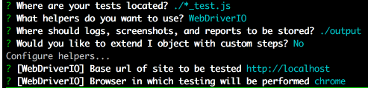
Codecept.js
$ codeceptjs init
Generate a config of codecept.js

Slide 40
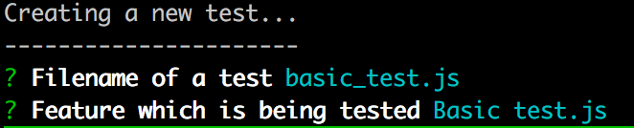
Codecept.js
$ codeceptjs gt
Generate a basic test.js of codecept.js

Slide 41
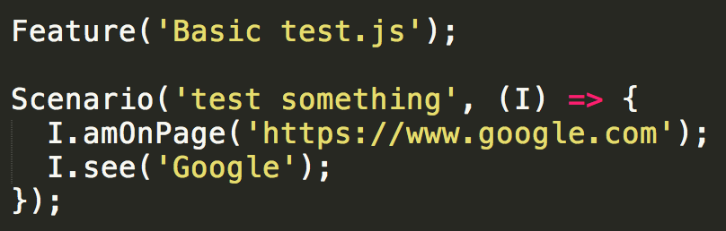
Codecept.js
Edit basic_test.js file content

Slide 42
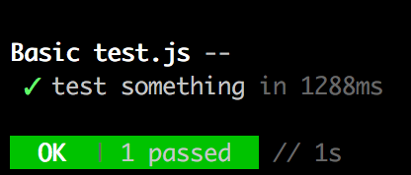
Codecept.js
$ codeceptjs run
Runs codecept.js test

Slide 43

sssss

Slide 44
Playwright
Playwright is a Node library to automate the Chromium (opens new window), WebKit (opens new window)and Firefox (opens new window)browsers as well as
Electron (opens new window)apps with a single API.
It enables cross-browser web automation that is ever-green, capable, reliable and fast
Playwright was built similarly to Puppeteer (opens new window), using its API and so is very different in usage. However, Playwright has cross browser support with better design for test automation.

Slide 45
Web driver
The standard and proved way to run browser test automation over years is Selenium WebDriver.

Slide 46
Puppeteer
Among all Selenium alternatives the most interesting emerging ones are tools developed around Google Chrome DevTools Protocol (opens new window). And the most prominent one is Puppeteer (opens new window). It operates over Google Chrome directly without requiring additional tools like ChromeDriver. So tests setup with Puppeteer can be started with npm install only. If you want get faster and simpler to setup tests, Puppeteer would be your choice.

Slide 47
Protractor
Protractor (opens new window)is an official tool for testing AngularJS applications. CodeceptJS should not be considered as alternative to Protractor, but rather a testing framework that leverages this powerful library.

Slide 48
Codecept.js locator

Slide 49
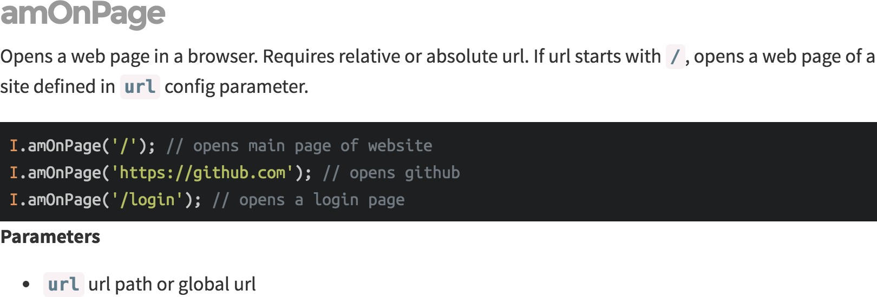
I.amOnPage
http://codecept.io/helpers/WebDriverIO/#amonpage

Slide 50
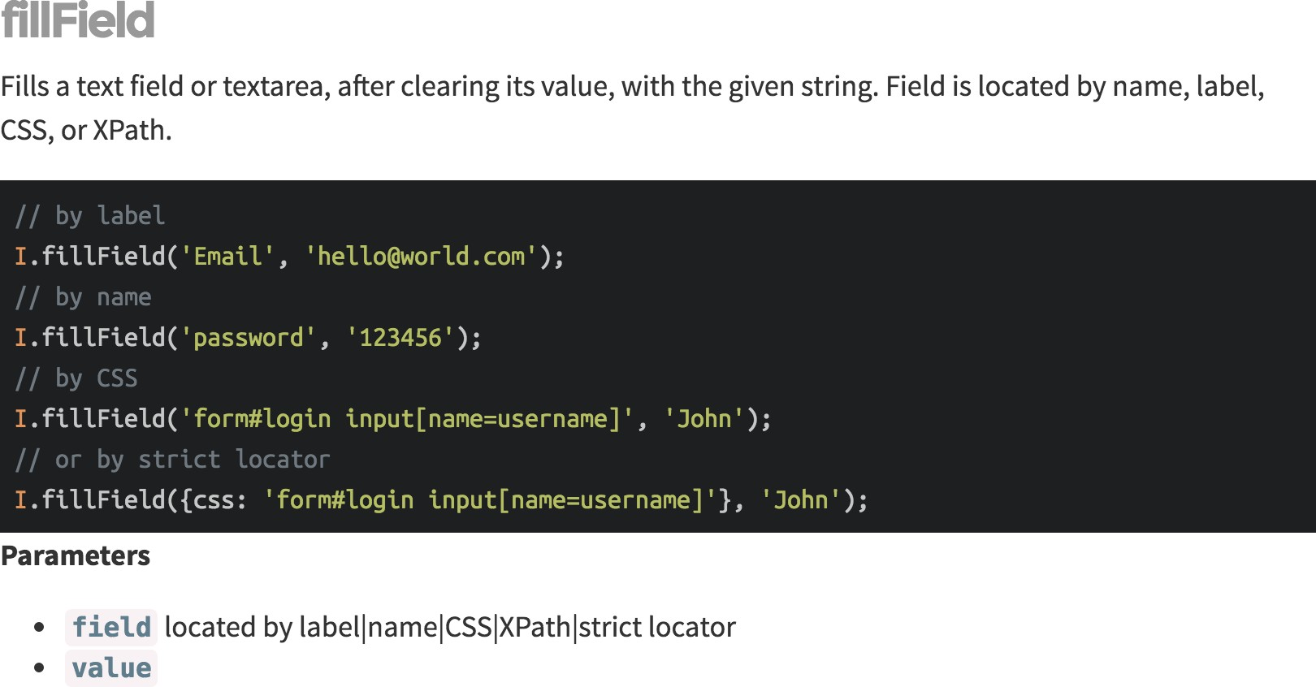
I.fillField
http://codecept.io/helpers/WebDriverIO/#fillfield

Slide 51
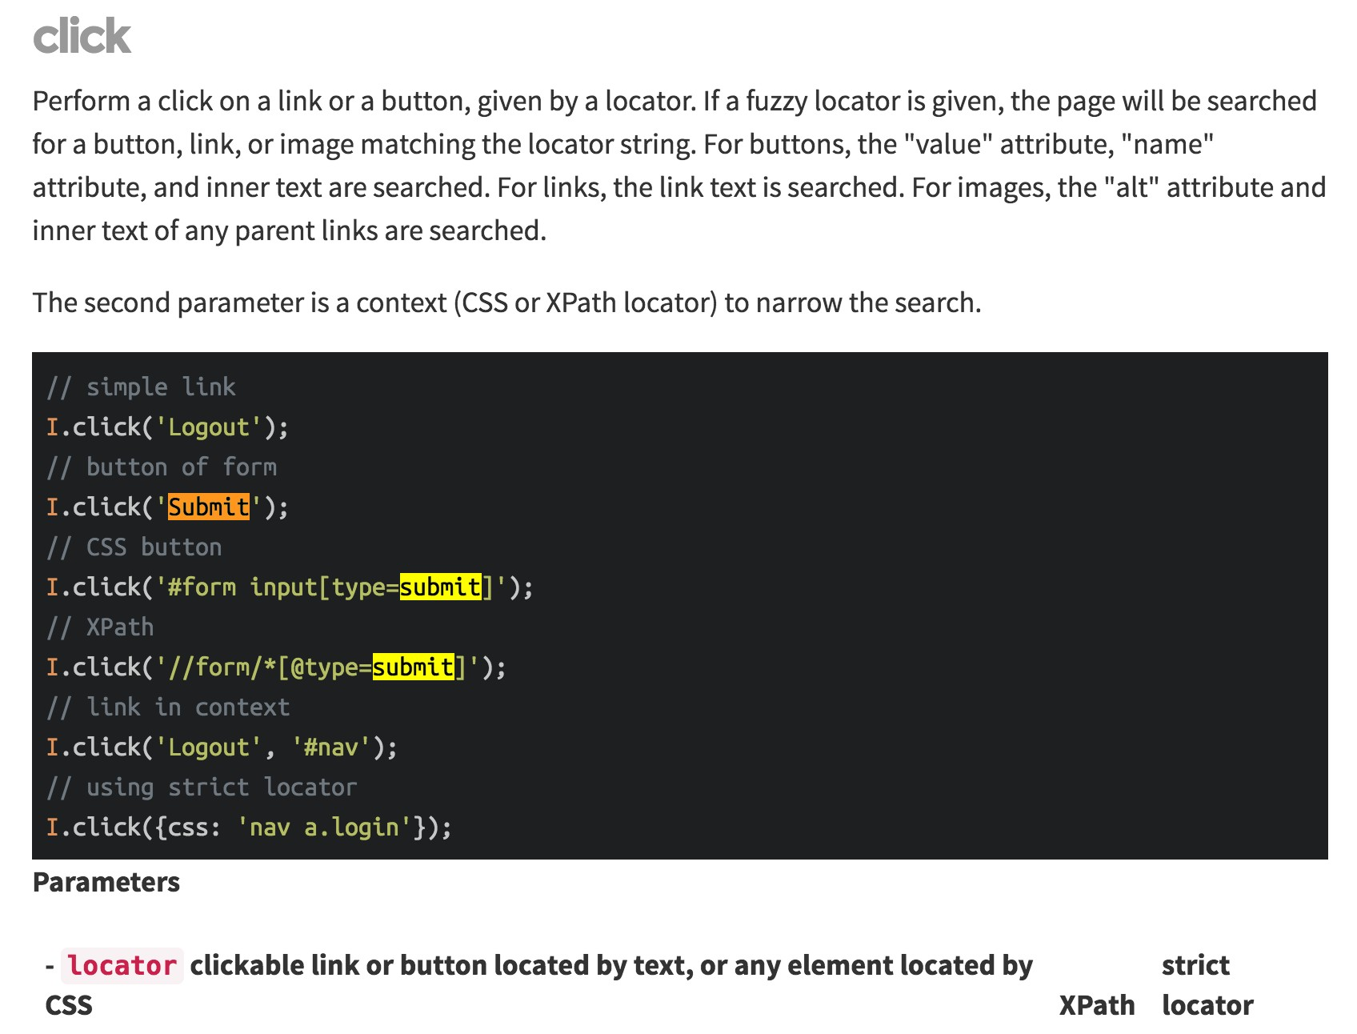
I.click
http://codecept.io/helpers/WebDriverIO/#fillfield

Slide 52
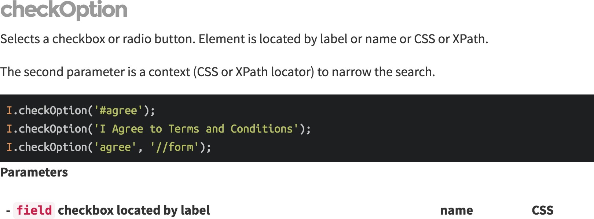
I.checkOption
http://codecept.io/helpers/WebDriverIO/#checkoption

Slide 53
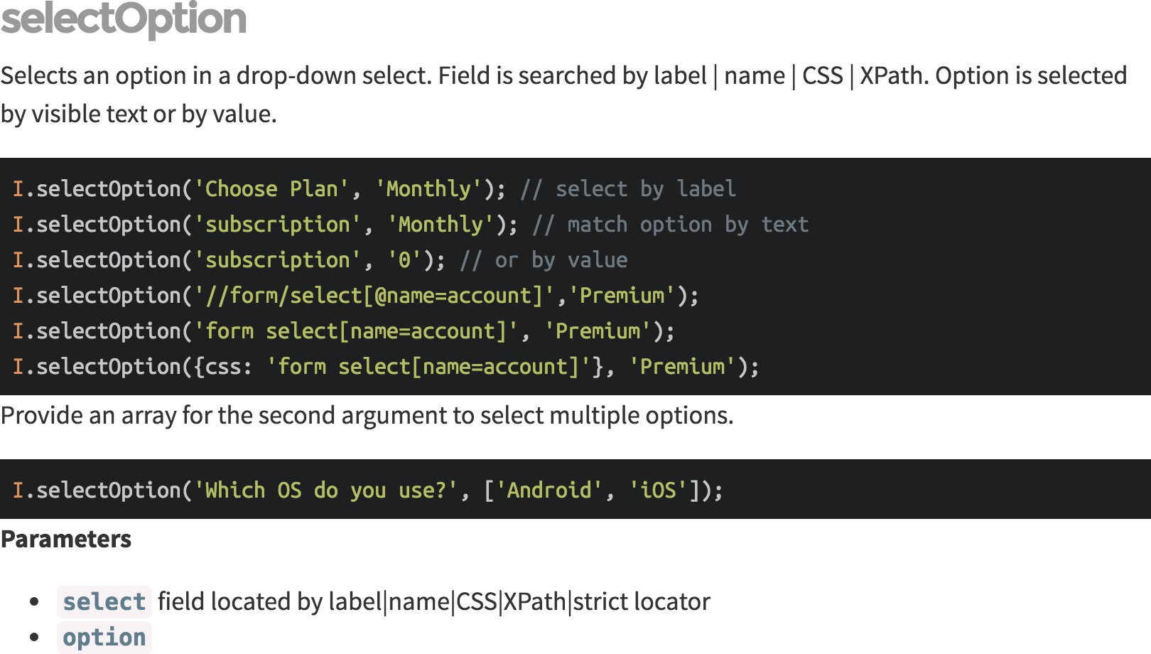
I.selectOption
http://codecept.io/helpers/WebDriverIO/#selectoption

Slide 54
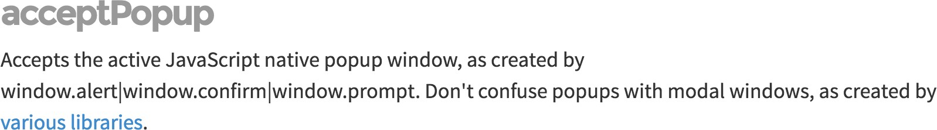
I.acceptPopup I.cancelPopup
http://codecept.io/helpers/WebDriverIO/#acceptpopup

Slide 55
Codecept.js assertion

Slide 56
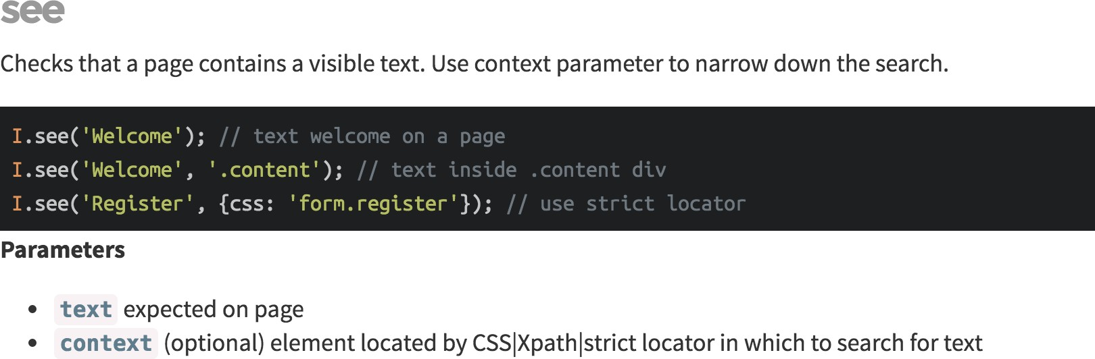
I.see
http://codecept.io/helpers/WebDriverIO/#see

Slide 57
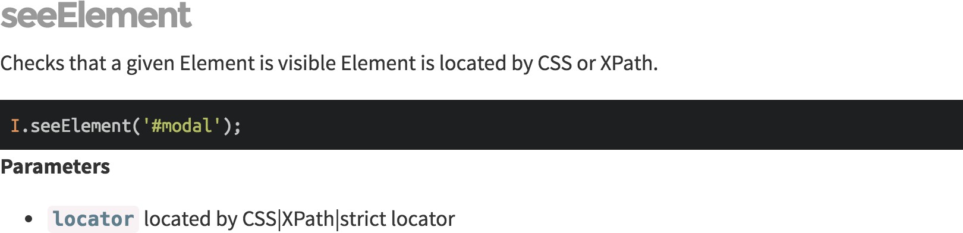
I.seeElement
http://codecept.io/helpers/WebDriverIO/#seeelement

Slide 58
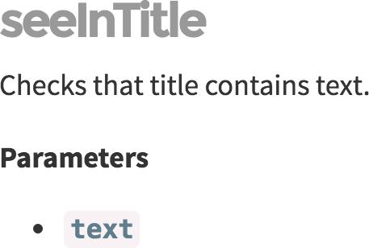
I.seeInTitle
http://codecept.io/helpers/Protractor/#seeintitle

Slide 59
Codecept.js helper

Slide 60
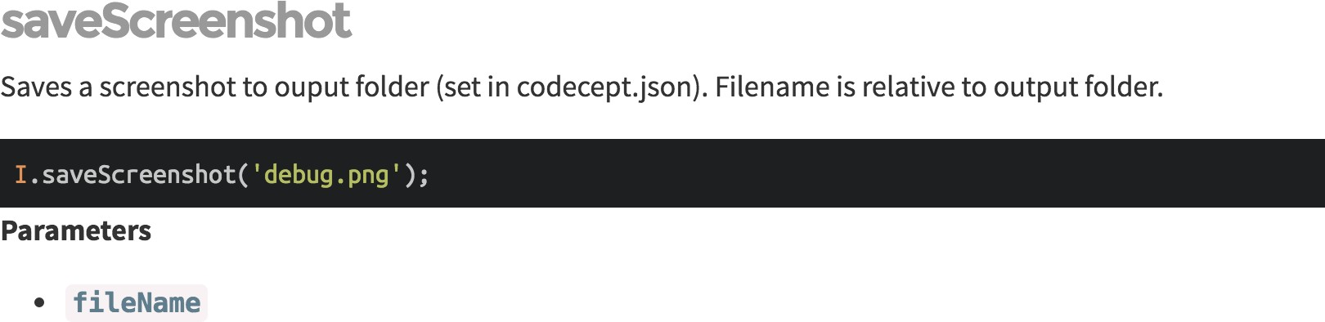
I.saveScreenshot
http://codecept.io/helpers/Protractor/#savescreenshot

Slide 61
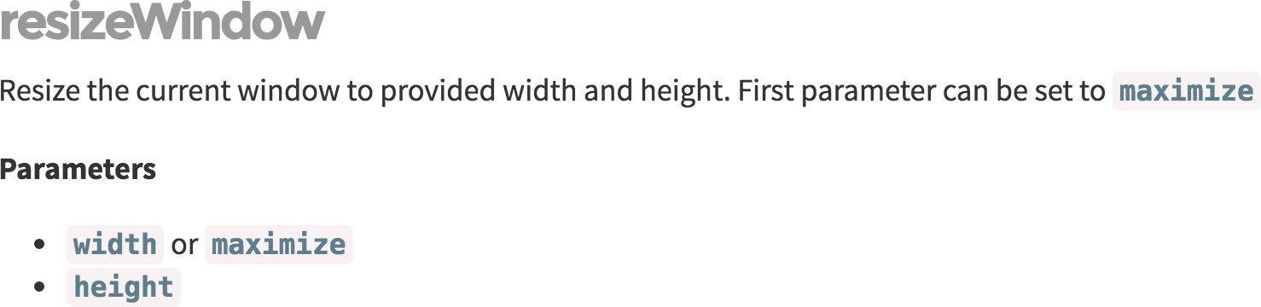
I.resizeWindow
http://codecept.io/helpers/Protractor/#resizewindow

Slide 62
I.acceptPopup I.can cancelPopup
http://codecept.io/helpers/WebDriverIO/#acceptpopup

Slide 64
Codecept.js comprare

Slide 65

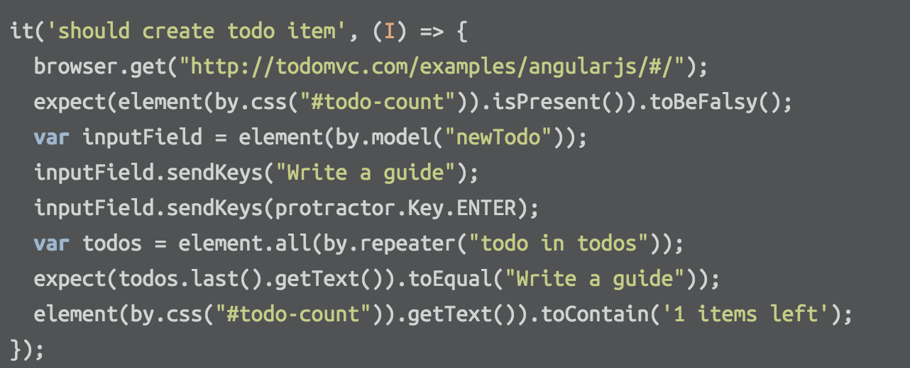
codecept.io
Protractor

Slide 66
Codecept.js recap
•
Support popular test framework (mostly)
•
Not another test framework
•
Make people easy to use
•
Make people easy to read

Slide 67
Codecept.js recap
•
Support popular test framework (mostly)
•
Not another test framework
•
Make people easy to use
Make people easy to read
But have to know …

